Slide 1
Data Analysis of INX Employees
by Mukesh Choudhary

Slide 2
Problem Statement
Mr. Brain decided to initiate a data science project , which analyses the current employee data and find the core underlying causes of this performance issues. Mr. Brain, being a data scientist himself, expects the findings of this project will help him to take right course of actions. He also expects a clear indicators of non performing employees, so that any penalization of non-performing employee, if required, may not significantly affect other employee morals.

Slide 3
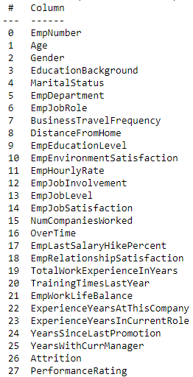
Data Description
Data has 1200 rows and 28 columns

Slide 4
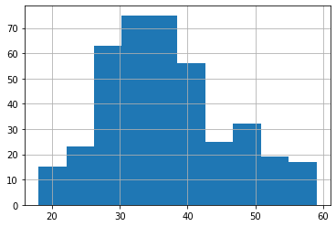
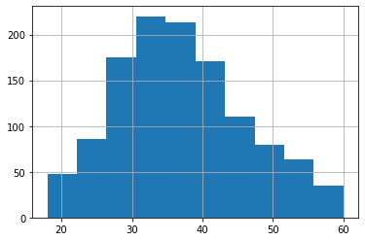
Sample
To do analysis on the data sample of 400 random rows is taken and the sample of data follows the Normal Distribution
Both sample and entire data Age column Hist graph are shown below
Fig1.Histogram of sample data(age.hist)
Fig2.Histogram of entire data(age.hist)

Slide 5
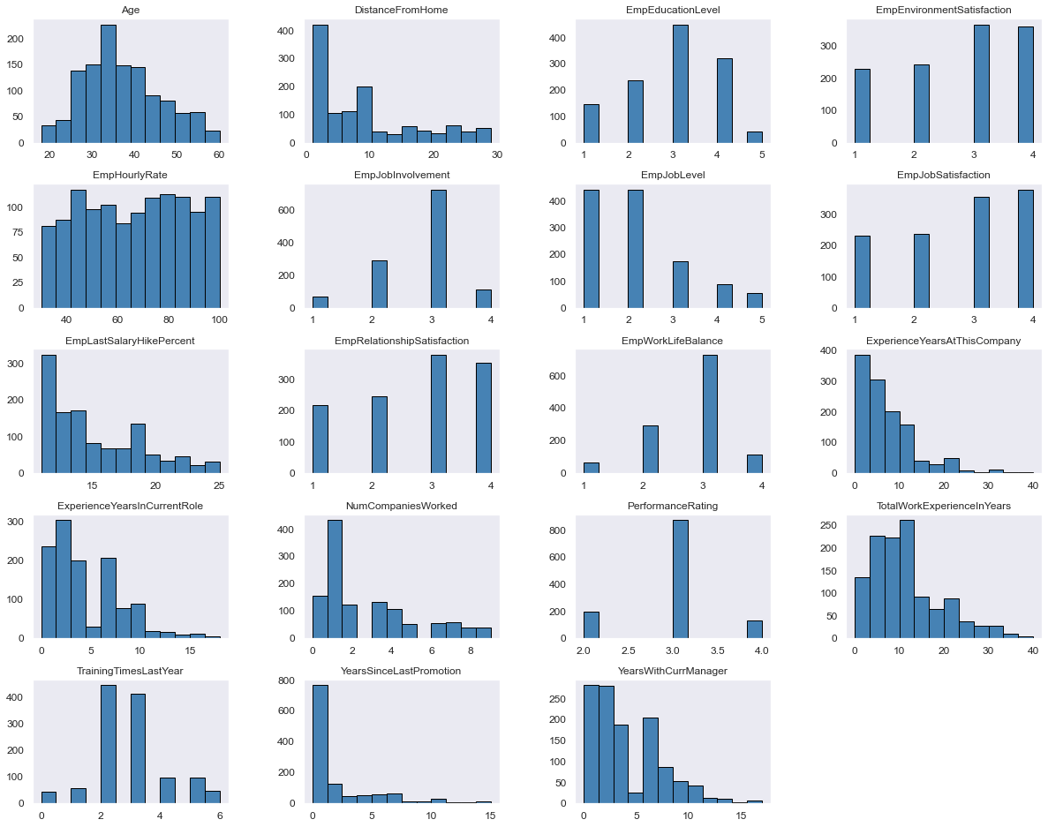
Histogram of all columns

Slide 6
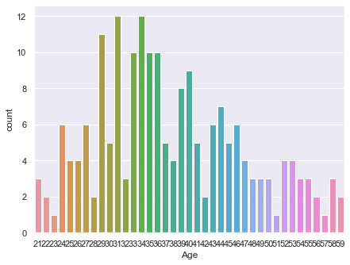
Age of employee
Mean of age’s is 36.807500
Std is 8.866057
Min age group is 18 years
Max age group is 59

Slide 7
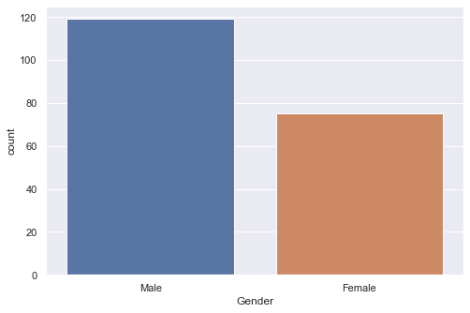
Gender
There are 119 male employee
75 female employee
Who are performing at 2

Slide 8
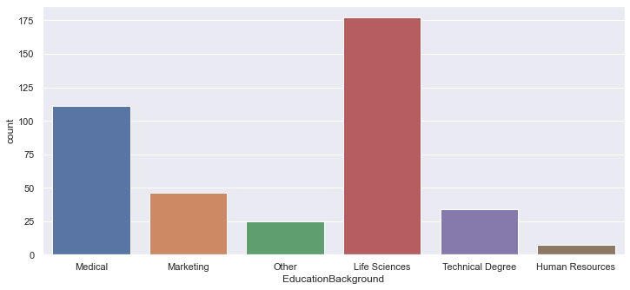
Education Background
Life Sciences 78
Medical 63
Marketing 29
Technical Degree 18
Other 3
Human Resources 3

Slide 9
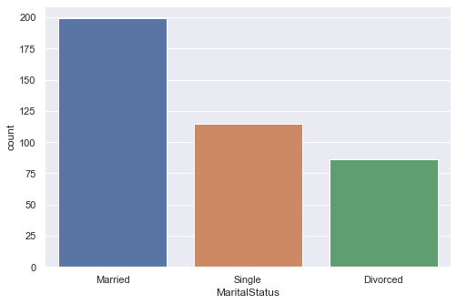
Martial Status
Married 100
Single 57
Divorced 37

Slide 10
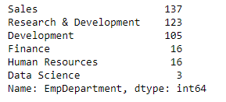
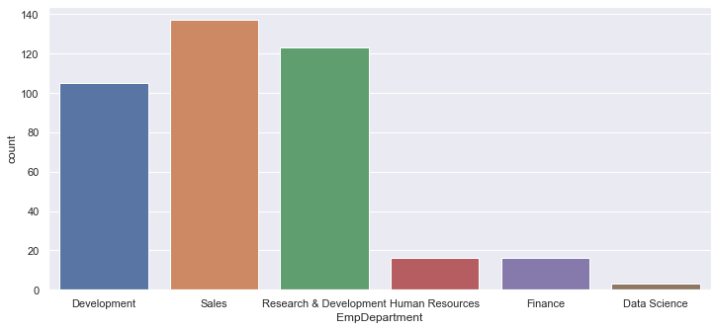
Employees Department

Slide 11
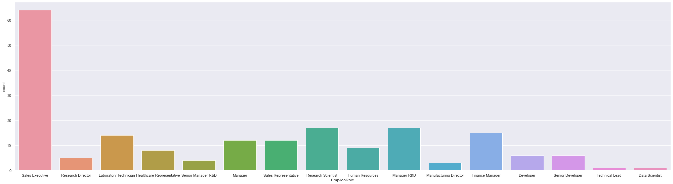
Employees Job Role
Sales Executive 64
Manager R&D 17
Research Scientist 17
Finance Manager 15
Laboratory Technician 14
Manager 12
Sales Representative 12
Human Resources 9
Healthcare Representative 8
Developer 6
Senior Developer 6
Research Director 5
Senior Manager R&D 4
Manufacturing Director 3
Data Scientist 1
Technical Lead 1

Slide 12
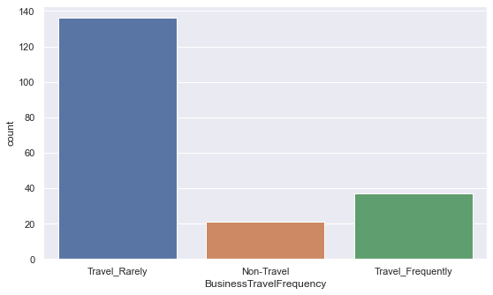
Business Travel Frequency
Travel_Rarely 136
Travel_Frequently 37
Non-Travel 21

Slide 13
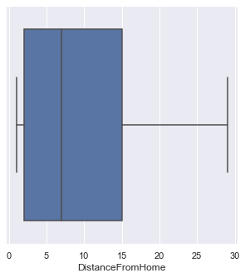
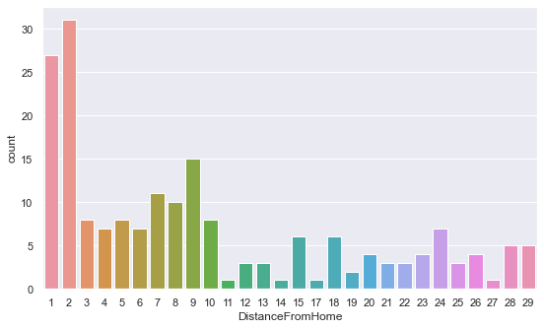
Distance From Home

Slide 14
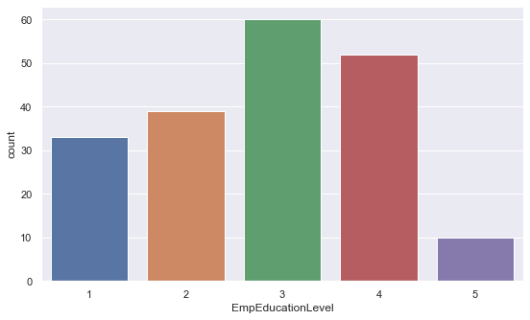
Employees Education Level
Emp Education Level | 1 'Below College'
 | 2 'College'
 | 3 'Bachelor'
 | 4 'Master'
 | 5 'Doctor'

Slide 15
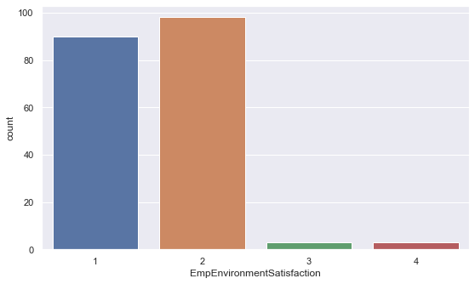
Employees Environment Satisfaction
Emp EnvironmentSatisfaction | 1 'Low'
 | 2 'Medium'
 | 3 'High'
 | 4 'Very High'

Slide 16
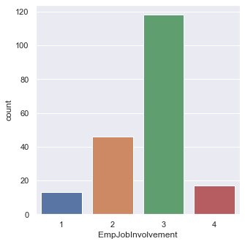
Employees Job Involvement
Emp Job Involvement | 1 'Low'
 | 2 'Medium'
 | 3 'High'
 | 4 'Very High'

Slide 17
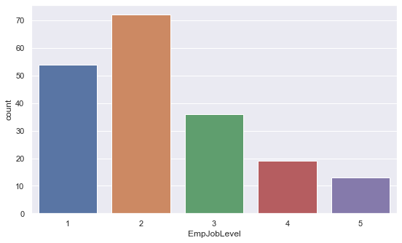
Employee Job Level
2 72
1 54
3 36
4 19
5 13
Name: EmpJobLevel

Slide 18
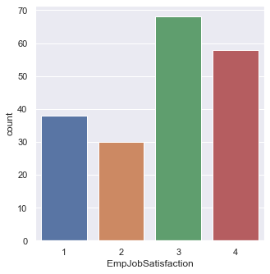
Employee Job Satisfaction
Emp Job Satisfaction | 1 'Low'
 | 2 'Medium'
 | 3 'High'
 | 4 'Very High'
3 68
4 58
1 38
2 30
Name: EmpJobSatisfaction

Slide 19
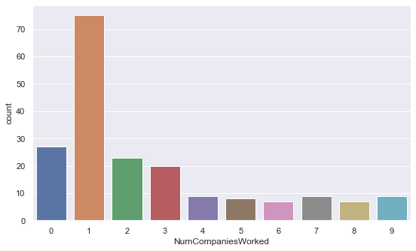
Employee worked in Number of companies
On x axis count is nothing but number of emplooyes

Slide 20
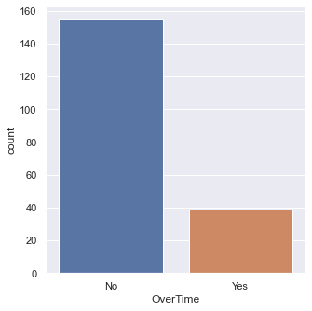
Employee working overtime
No 155
Yes 39
Name: Over Time

Slide 21
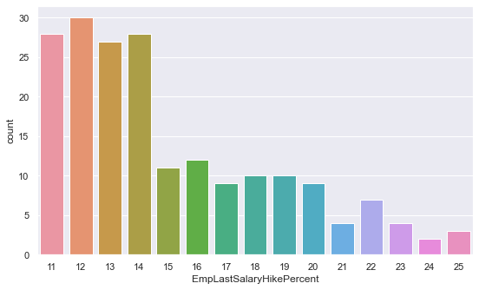
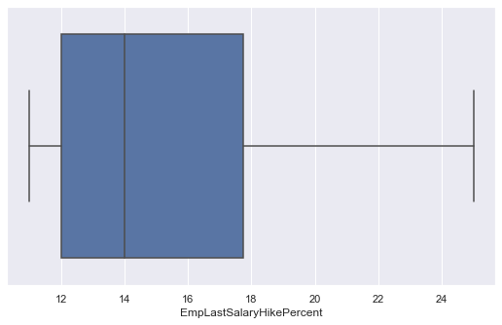
Employee Last Salary Hike Percent
On x axis count is number of employees

Slide 22
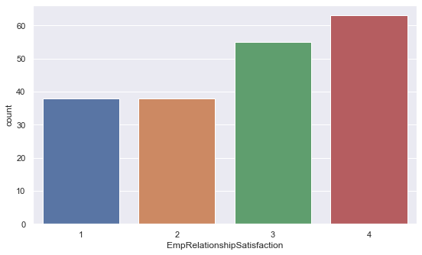
Employee Relationship Satisfaction
4 63
3 55
2 38
1 38
Name: Employee Relationship Satisfaction
Relationship Satisfaction | 1 'Low'
 | 2 'Medium'
 | 3 'High'
 | 4 'Very High'

Slide 23
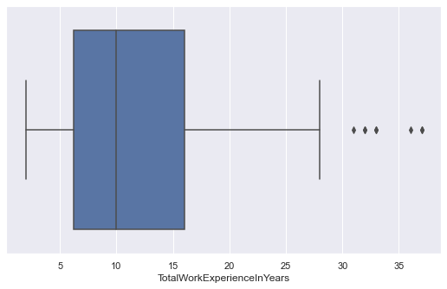
Total Work Experience In Years
By box plot the values which are above 32 are outliers
Most of the employee has 7 to 18 years of work experience in total

Slide 24
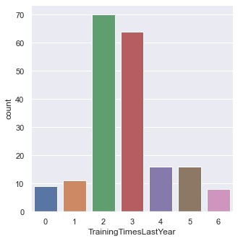
Training Time Last Year
2 70
3 64
5 16
16
1 11
0 9
6 8
Name: Training Times Last Year

Slide 25
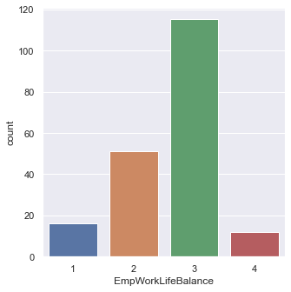
Employee Work Life Balance
Emp Work Life Balance | 1 'Bad'
 | 2 'Good'
 | 3 'Better'
 | 4 'Best'

Slide 26
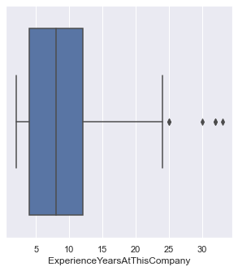
Experience Years At This Company
By this boxplot above 25 years are outliers
The more number of employee having experience between 4 to 10 years
There are few employees who worked more than 35 years in INX

Slide 27
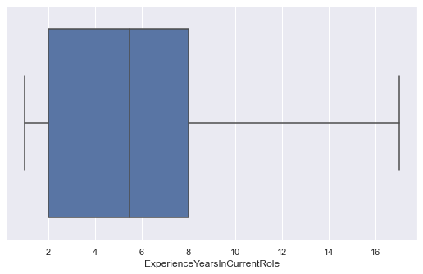
Experience Years In Current Role
Most of the employee having exp from 2 to 7 years
Very few having exp of above 15 years in the current role

Slide 28
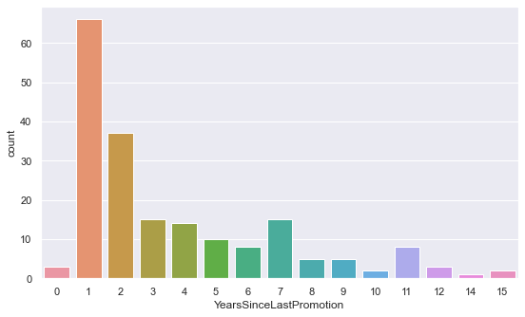
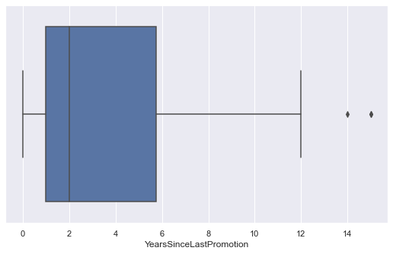
Years Since Last Promotion
In box plot between 1 to 6 years of employee has got promotion and very few are above 12

Slide 29
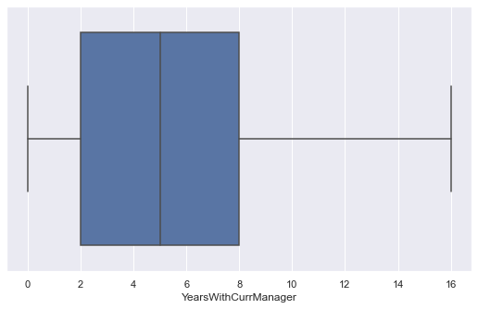
Years With Current Manager
Many of the employee have years in between 2 to 7
Very few are more than 15

Slide 30
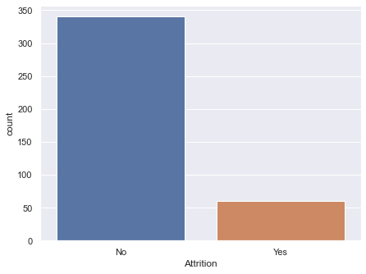

Attrition
In Yes category 60employee are removed from workforce

Slide 31
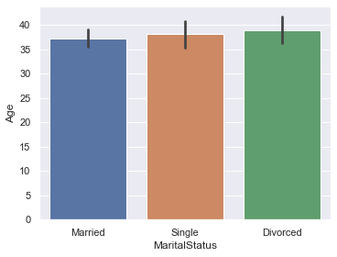
Bivariant Analysis of those are performing at 2
Martial status and age comparison
Age of employees above 37 are divorced in many cases
And Martial status of married employees has age near to 36
Even single employees have age near to 35 to 36 in some of the cases

Slide 32
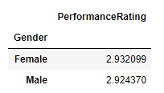
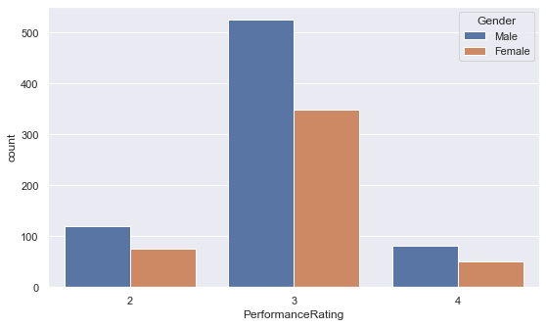
Performance and Gender
There is not much difference in Performance rating
As in Sample data and population the count of male is more than female
By seeing count plot in performance 3 male are more than female

Slide 33
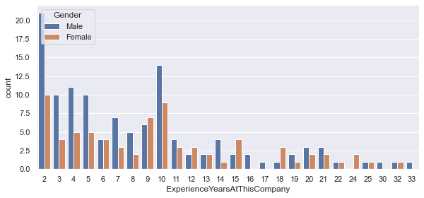
Experience at this company and Gender
 | Experience Years At This Company
Gender
Female | 9.893333
Male | 8.596639
Count is on y axis is number of employees and x is experience at this company

Slide 34
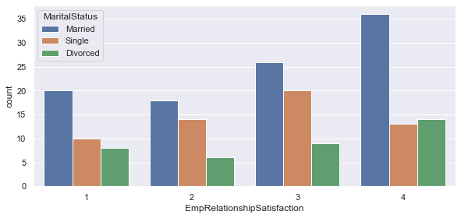
Employees environment satisfaction and Martial Status
 | Employee Relationship Satisfaction
MaritalStatus
Divorced | 2.783784
Married | 2.780000
Single | 2.631579

Slide 35
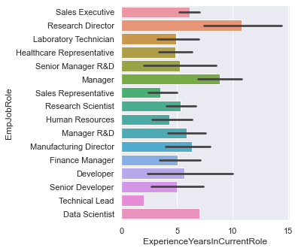
Years with current Job Role and Employee Job Role
 | Experience Years In Current Role
Emp Job Role
Data Scientist | 7.000000
Developer | 5.666667
Finance Manager | 5.066667
Healthcare Representative | 4.875000
Human Resources | 4.333333
Laboratory Technician | 4.928571
Manager | 8.833333
Manager R&D | 5.882353
Manufacturing Director | 6.333333
Research Director | 10.800000
Research Scientist | 5.352941
Sales Executive | 6.156250
Sales Representative | 3.500000
Senior Developer | 5.000000
Senior Manager R&D | 5.250000
Technical Lead | 2.000000

Slide 36
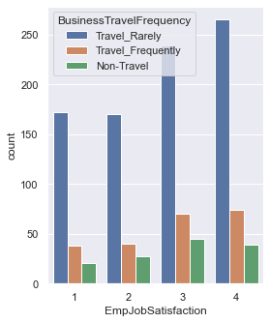
Employees job satisfaction and Business Travel Frequency
 | Emp Job Satisfaction
BusinessTravelFrequency
Non-Travel | 2.666667
Travel_Frequently | 3.027027
Travel_Rarely | 2.691176

Slide 37
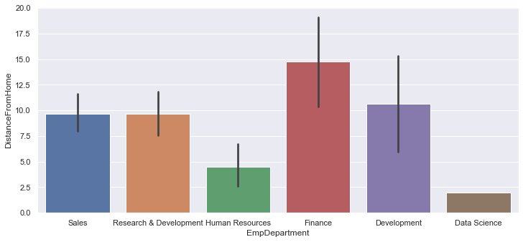
Employees Deaprtment and Distance from Home
 | Distance From Home
EmpDepartment
Data Science | 2.000000
Development | 10.615385
Finance | 14.733333
Human Resources | 4.500000
Research & Development | 9.691176
Sales | 9.689655

Slide 38
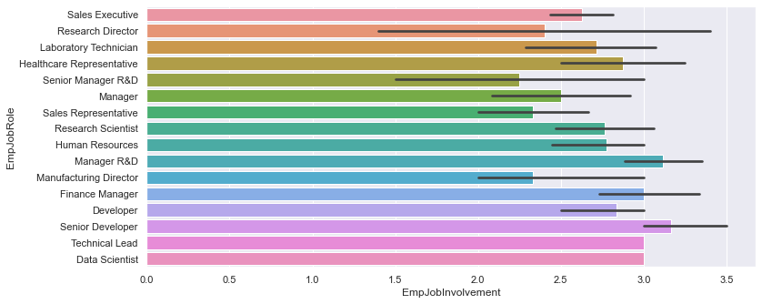
Employee Department and Employees Job involvement
 | Emp Job Involvement
Emp Job Role
Data Scientist | 3.000000
Developer | 2.833333
Finance Manager | 3.000000
Healthcare Representative | 2.875000
Human Resources | 2.777778
Laboratory Technician | 2.714286
Manager | 2.500000
Manager R&D | 3.117647
Manufacturing Director | 2.333333
Research Director | 2.400000
Research Scientist | 2.764706
Sales Executive | 2.625000
Sales Representative | 2.333333
Senior Developer | 3.166667
Senior Manager R&D | 2.250000
Technical Lead | 3.000000

Slide 39
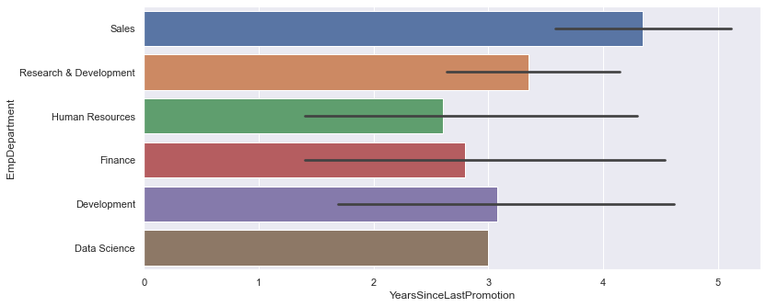
Years since last promotion and employees department
 | Years Since Last Promotion
EmpDepartment
Data Science | 3.000000
Development | 3.076923
Finance | 2.800000
Human Resources | 2.600000
Research & Development | 3.352941
Sales | 4.344828

Slide 40
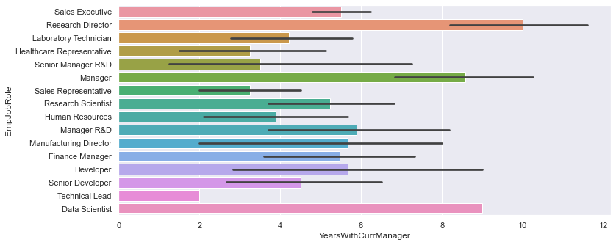
Years with current manager and employee job role
Research Director ad data scientist has the higher years with current manager
 | Years With Current Manager
EmpJobRole
Data Scientist | 9.000000
Developer | 5.666667
Finance Manager | 5.466667
Healthcare Representative | 3.250000
Human Resources | 3.888889
Laboratory Technician | 4.214286
Manager | 8.583333
Manager R&D | 5.882353
Manufacturing Director | 5.666667
Research Director | 10.000000
Research Scientist | 5.235294
Sales Executive | 5.500000
Sales Representative | 3.250000
Senior Developer | 4.500000
Senior Manager R&D | 3.500000
Technical Lead | 2.000000

Slide 41
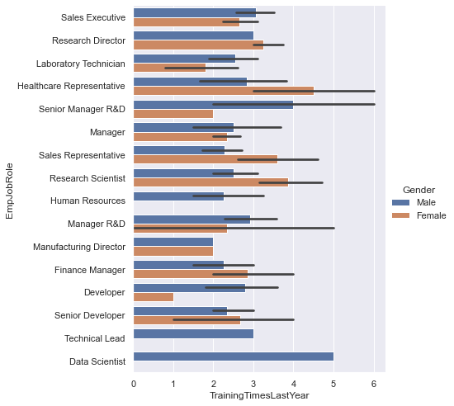
Training time last year and emp job role
 | Training Time Last Year
EmpJobRole
Data Scientist | 5.000000
Developer | 2.500000
Finance Manager | 2.533333
Healthcare Representative | 3.250000
Human Resources | 2.000000
Laboratory Technician | 2.285714
Manager | 2.416667
Manager R&D | 2.823529
Manufacturing Director | 2.000000
Research Director | 3.200000
Research Scientist | 3.058824
Sales Executive | 2.875000
Sales Representative | 2.833333
Senior Developer | 2.500000
Senior Manager R&D | 3.500000
Technical Lead | 3.000000

Slide 42
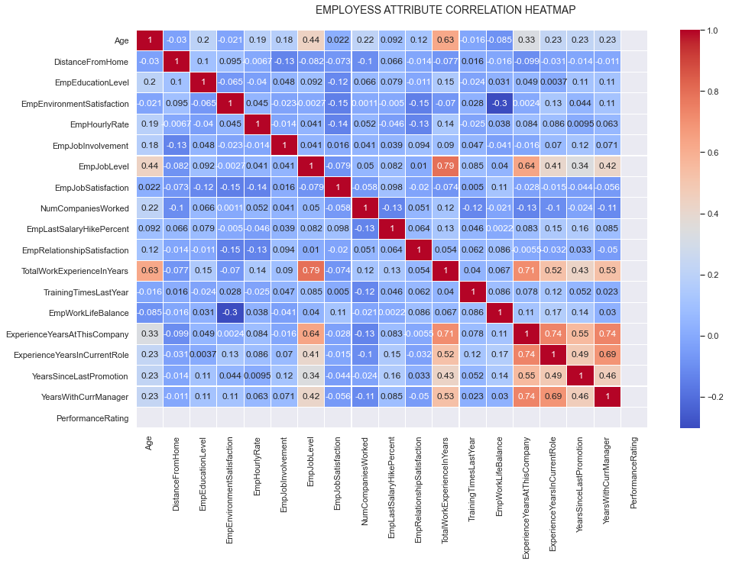
Correlation of employees attributes
In heatmap where there are more warm colors
Like years with current manager and more
This are the important columns for performance of the employee
Major number of employees performance

Slide 43
Report On Data
In Total there are 194 employees Performing at 2
In sales Department there are 87 employees
In Research and Development there are 68 employees
In finance Department there are 15 employees
In Development Department there are 13 employees
In Human Resources Department there are 10 employees
In Data Science Department there is 1 employee

Slide 44
Sales Department
In sales department there are 87 employee
In sales department there are 7 employee having a bad work life balance
Out of which 6 are sales executive and 1 sales representative
Even employees environment satisfaction is on of the problem for sales department. A lot of employees are not satisfied
Employee who showing less Job involvement are affecting the performance in sales Department

Slide 45
Development Department
Technical lead is not performing this might be because of employee relationship satisfaction
In developer role in females there can be a problem of distance from home and male and female employee environment satisfaction is also the problem
Senior developer are not performing because of distance from home and also employee environment satisfaction
Also years with current manager is also affecting the performance in some case there might be need of shuffle and even martial status is also a factor in some job role of development department

Slide 46
Finance
In finance there are overall people who are not performing are 15
There are 8 males and 7 females
For finance manager employee environment satisfaction and also Distance from Home is a cause
Years of experience at this company is a cause overall they are carrying 10+ years of experience this might be making overconfident
There a low job satisfaction in a male finance manager

Slide 47
Human Resources
In Human resources there are 10 employee performing at worst
For Manger’s in Human and Resources department employee environment satisfaction is low
Also for HR department manger has a high Hourly payment and their experience at this company is lot so might be a cause of not performance due to over confidence
For Human and resources employee job level is low and also training time last year is 0 in female employee

Slide 48
Research and development
In Research and Development there are 68 employees
Training time of last year can be the cause of the employee
For Laboratory Technician their job Level is low and also years with current manager in case of people are doing over time
Overall In manger R and D role employee are divorced are having overall more than 10 years of experience in company and also with current manager and they are from last 8 years in same role and employee environment satisfaction
For manufacturing director job role in gender female there a distance from home problem
Research director are not performing because of experience they have gained might be making them overconfident

Slide 49
Research and Development
Research scientist who are doing overtime are getting under pay then those scientist who are not doing over time and even employee environment satisfaction , emplooye job role are low
For senior manager of R and D are not performing due to employees enviornment satisfaction and also years with current manager is the cause for those senior manager in R and D are single

Slide 50
Data science
There is only one data scientist who is not performing because of employee environment satisfaction

